Slide 1
QR Code-Based Smart Office Seat Allocation System
Team Name & Members:
AI ALCHEMISTS
ARYAN PATEL,AMULYA K R,AMBATI LOKESH REDDY,ASHVIJA VM
Hack-A-League 3.0, Global Academy of Technology -1st and 2nd Feb

Slide 2
Problem Statement
Offices today are plagued by inefficient seat allocation methods, leading to wasted time and confusion for employees.
In hybrid work environments, manual seat assignments become a challenge, and real-time tracking is nonexistent.
Current solutions are outdated and not user-friendly.
Supporting Statistics:
80% of companies report inefficiencies in office space management.
Hybrid work models demand flexible seating solutions for optimal space utilization.

Slide 3
Our Game-Changing Solution
Smart Office Seat Allocation Using QR Codes
Scan QR Code - Instantly see real-time seat availability.
Reserve or Occupy a Seat in seconds, reducing time spent searching for a spot.
No app installation needed – Fully web-based and mobile responsive.
Dynamic Seat Updates – Available or occupied seats update in real time.
Why It Works:
-Instant and Seamless
-Reduces Confusion and Saves Time
-Scalable and Easy to Implement

Slide 4
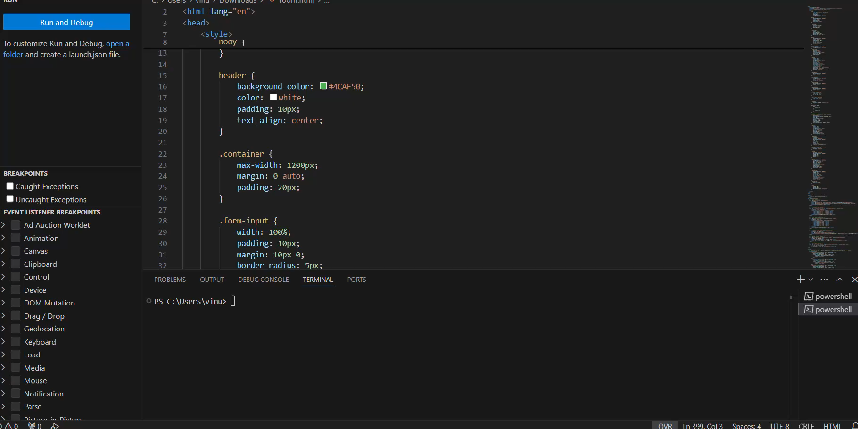
Live Demo / Working Prototype

Slide 5
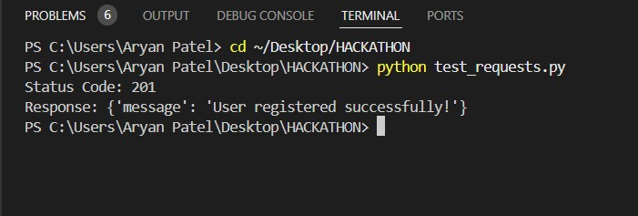

Slide 6
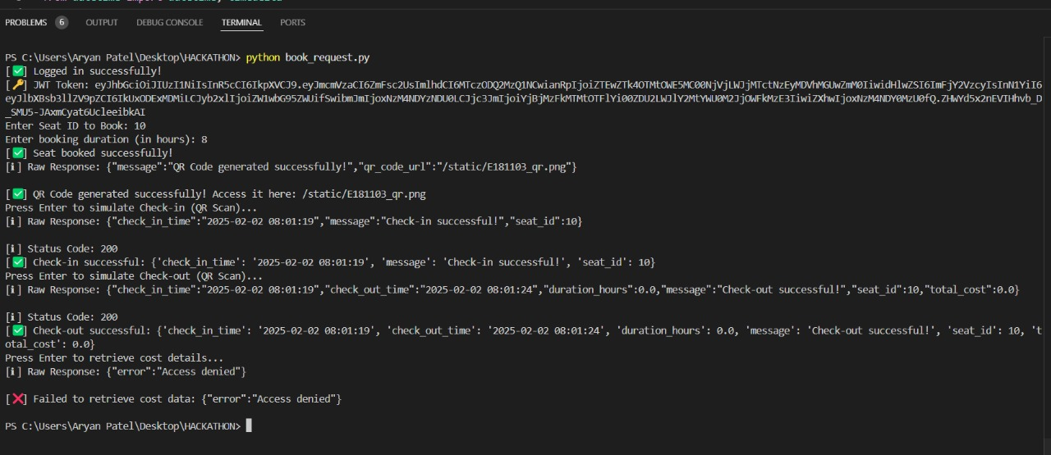

Slide 7
Technology Stack
Frontend Technologies:
HTML, CSS, JavaScript for building the web application.
QR Code Scanner – JavaScript-based library for handling QR code scanning
and processing.
Real-time Updates – Firebase Firestore / WebSockets for live data updates.
Backend :
Node.js /Flask -For handling user data, seat reservations, and real-time
interactions

Slide 8
Competitive Edge
Why Our System Stands Out:
Real-Time Dynamic Updates – No manual intervention needed for seat status changes.
Web-Based Solution – No app required; accessible on any device.
Interactive & Professional UI – Seamless user experience with clean animations and responsive design.
Comparison with Existing Solutions:
Our System: Quick, dynamic updates, no app installation required, mobile-responsive.
Traditional Systems: Static, require app installation, limited accessibility

Slide 9
Business & Scalability Potential
Revenue Model:
SaaS model for co-working spaces and corporate offices.
Integration with access control systems for seamless entry and seat allocation.
Future Scope:
AI-based Seat Recommendations – Based on user preferences and activity patterns.
IoT Integration – For smart desks, lights, and more.
Voice-Controlled Seat Booking – Integration with Alexa and Google Assistant

Slide 10
Conclusion & Impact
Key Takeaways:
Optimizes office seating efficiency in real-time.
User-friendly and scalable for small or large office environments.
Reduces confusion and saves valuable time for employees.
Impact Statement:
"Our system creates a seamless, hassle-free experience for employees, increasing productivity and making office management more efficient than ever."

Slide 11
Thank You
Project Link:
https://github.com/ashvijavm/hack...project

